Slide 1
Input Devices

Slide 2
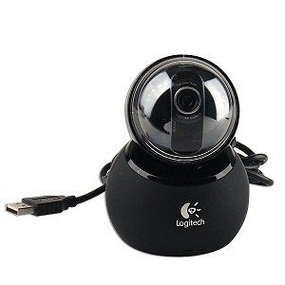
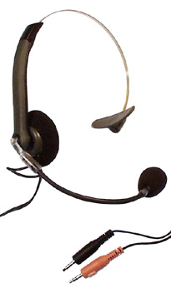
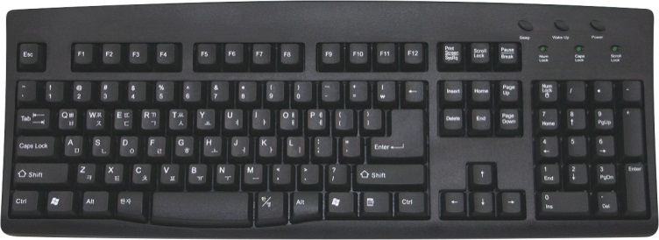
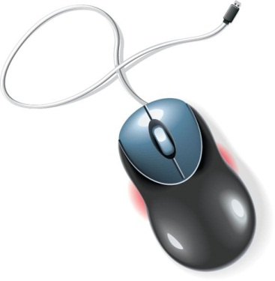
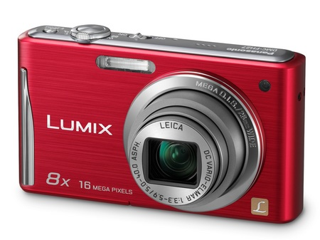
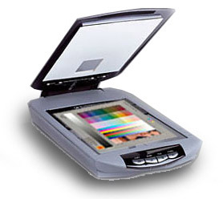
Input
Data or instructions entered into memory of computer
Input device is any hardware component used to enter data or instructions

Slide 3
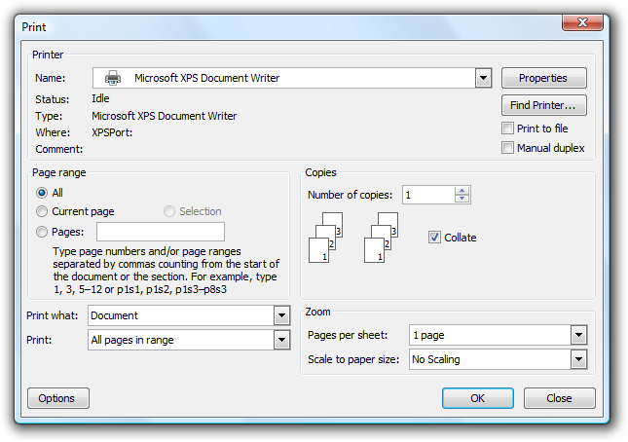
Input - Types
Data
  Unprocessed text, numbers, images, audio, and video
Commands
  Programs
  Commands
  User Responses

Slide 4
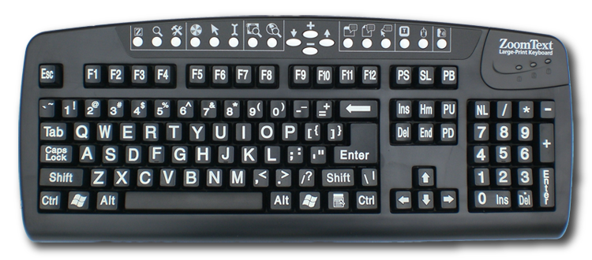
Keyboards

Slide 5
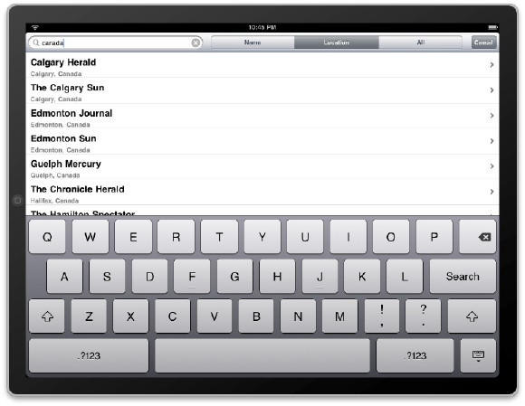
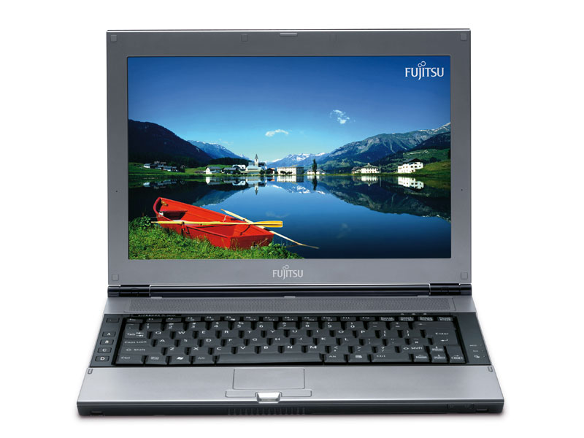
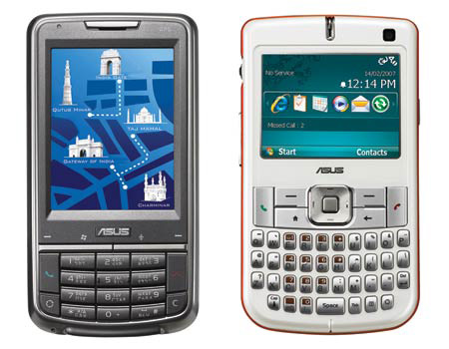
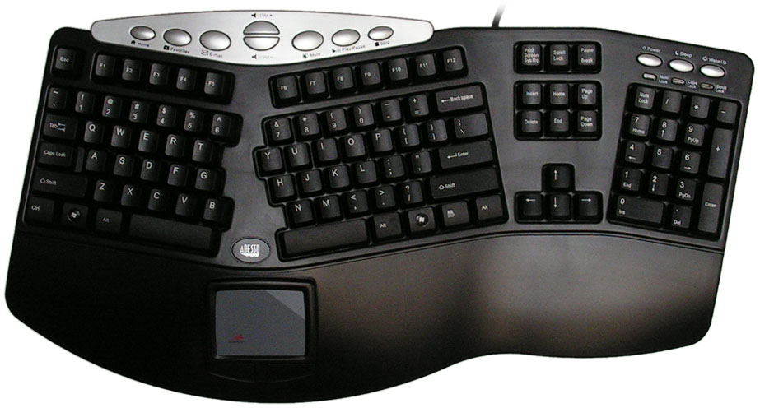
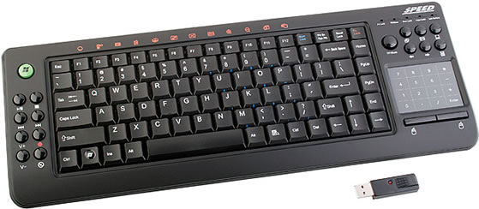
Keyboards - Types
Standard
Ergonomic
Wireless
Notebook
Handheld
On Screen

Slide 6
Pointing Devices
Pointing devices are used to
  select and manipulate objects
  input certain types of data
  to issue commands to the computer.

Slide 7
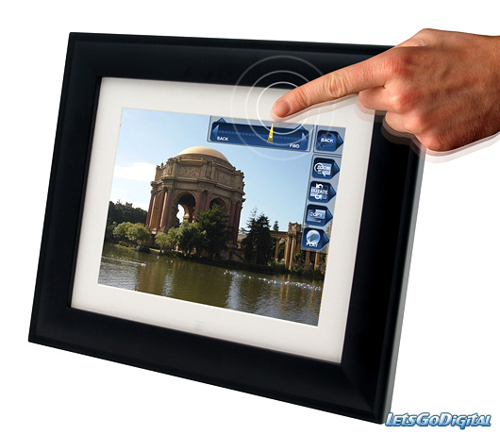
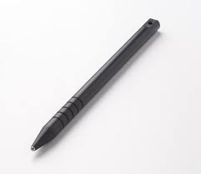
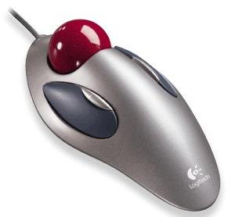
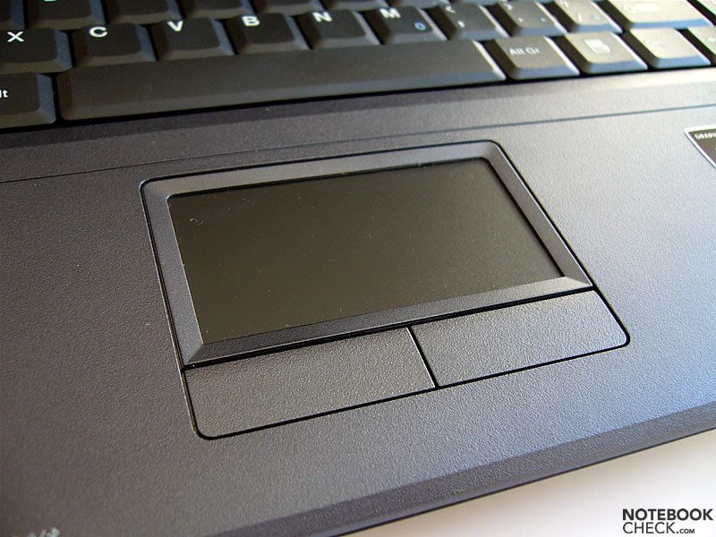
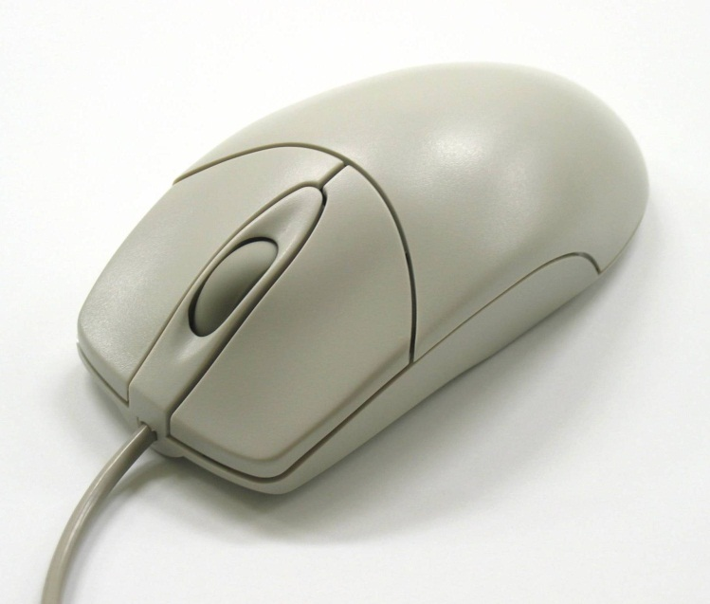
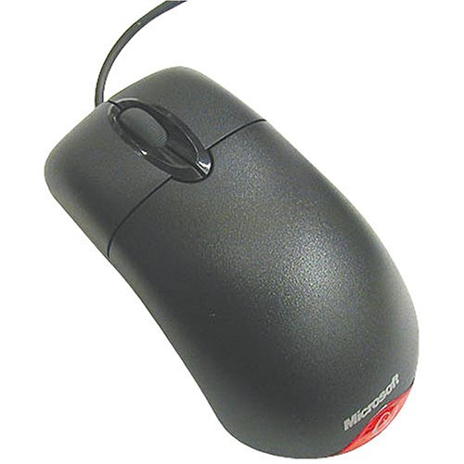
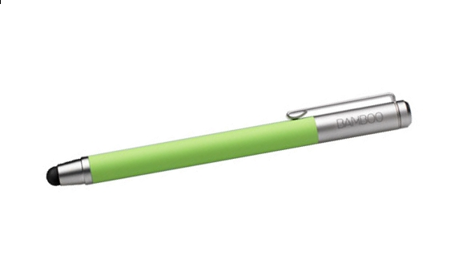
Pointing Devices
Wheel Mouse
Optical Mouse
Trackball
Touch Pad
Touch Screen
Stylus – Two Types
  Standard
  Inductive

Slide 8
Scanners
A scanner captures an image of a flat object in digital form and transfers that data to a computer.
The quality of scanned images is indicated by optical resolution, usually measured in the number of dots per inch (dpi).

Slide 9
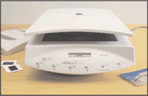
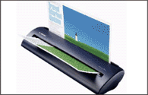
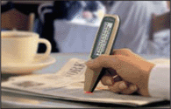
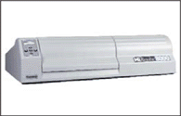
Scanners - Types
Flatbed
Sheet-fed
Pen or Handheld
Drum

Slide 10
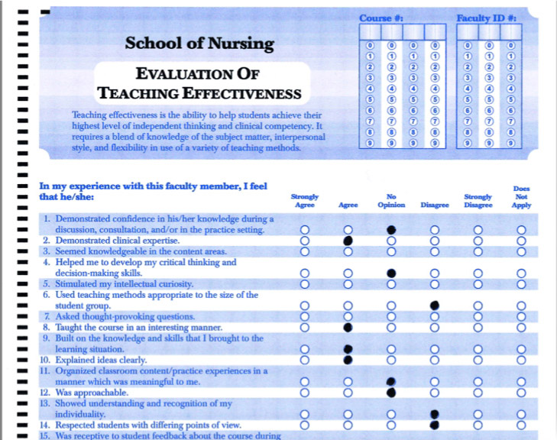
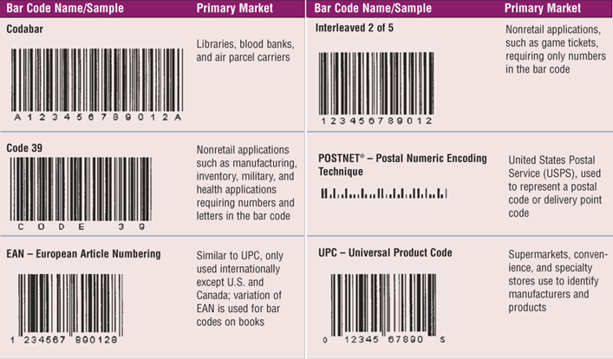
Optical Readers
Device that uses light source to read characters, marks, and codes and then converts them into digital data
  OMR
  Bar Code

Slide 11
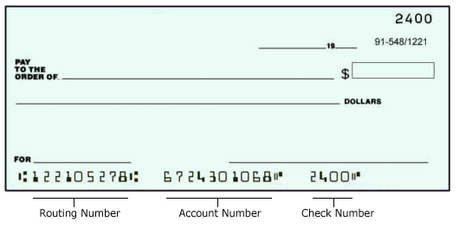
Magnetic-Ink Character Recognition (MICR)
Banking industry almost exclusively uses MICR for check processing

Slide 12
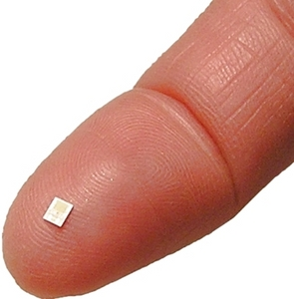
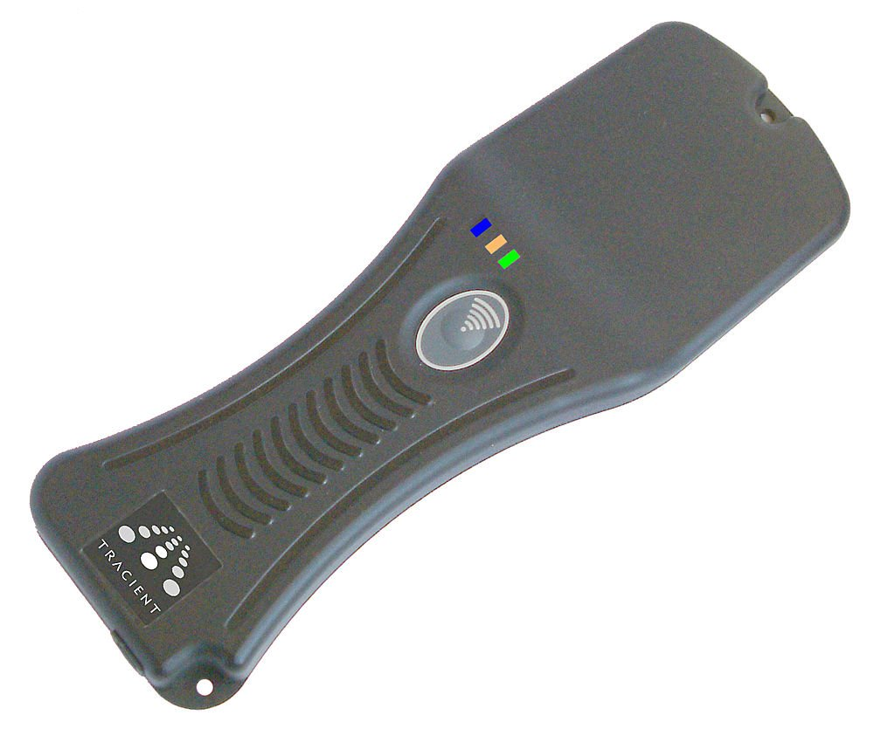
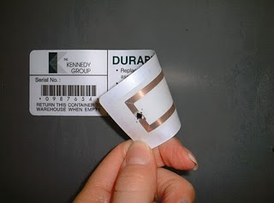
RFID
Radio frequency identification (RFID) is a technology that can store, read, and transmit data located in RFID tags.
RFID tags
  contain tiny chips and radio antennas
  can be attached to objects, such as products, price tags, shipping labels, ID cards, assets, and more.
The data in RFID tags is read by RFID readers.

Slide 13
Audio Input
Audio input is the process of entering audio data into the computer.
Speech recognition systems enable the computer to recognize voice input as spoken words and require appropriate software.
Music input systems are used to create an original music composition or arrangement, or to create a custom music CD.

Slide 14
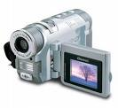
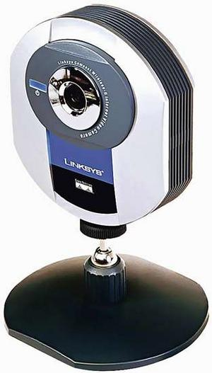
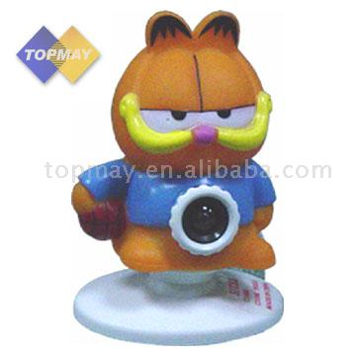
Video Input
Process of entering full-motion images into computer
Video can come form;
  Digital Video Recorders
  Web Cams

Slide 15


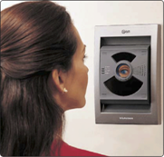
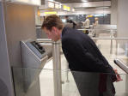
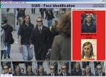
Biometric Input
Authenticates person’s identity by verifying personal characteristic
  Fingerprint scanner
  Hand geometry
  Voice verification
  Iris recognition
  Facial recognition

